Slide 1

Project Presentation Software Measurements
Team R : professor
Anusha Keralapura thandavamurthy – 40102962 dr. jinqiu yang
Jaswanth banavathu – 40080737
Arvind korchibettu adiga – 40105178
Kranthi kumar Sankuru – 40102793
Manushree mallaraju - 40082236

Slide 2
Contents
3) Selected Projects
4) Metrics Calculated
5) Issues faced
6) Branch and Code coverage
7 & 8) Test suite effectiveness
9) Code Complexity : McCabe
10) BMI
11) Defect Density
12 - 14) Correlations
15) Related work
16) References

Slide 3
Selected Projects
1) Apache Sling : 3.5million LOC
2) Apache Commons Lang : 80.7k LOC
3) Apache Commons Collections : 132k LOC
4) Apache Commons Math : 186k LOC
5) JFreeChart : 317k LOC

Slide 4
Metrics Calculated
1) Code Coverage
2) Branch Coverage
3) Test-suite Effectiveness (Mutation Testing)
4) McCabe Complexity
5) Backlog Management Index (BMI)
6) Post-release defect density

Slide 5
Issues Faced
1) Collection of working versions of the projects.
2) Maven issues due to incompatibility with eclipse.
3) Few projects took long time to build successfully. For eg : Apache Commons Math took approx. 24 hours to build.
Once these were setup :
Added dependency in POM.XML
Run goal or build Maven

Slide 6
JaCoCo : For statement and branch coverage (Metrics 1 & 2)
JaCoCo is a free code coverage library for Java, which has been created by the EclEmma team based on the lessons learned from using and integration existing libraries for many years.
It can be used to cover statement and branch coverages, code complexity (McCabe) and WMC for methods and classes respectively.
Provides results in both HTML and CSV formats.
Eg : For Apache Commons Collections :
Statement Coverage : 86 %
Branch Coverage : 82 %

Slide 7
Test Suite Effectiveness : Mutation Testing (Metric 3)
We used PI Test to perform mutation testing on selected projects
Steps :
Adding dependency in pom.xml
Executing goal

Slide 8
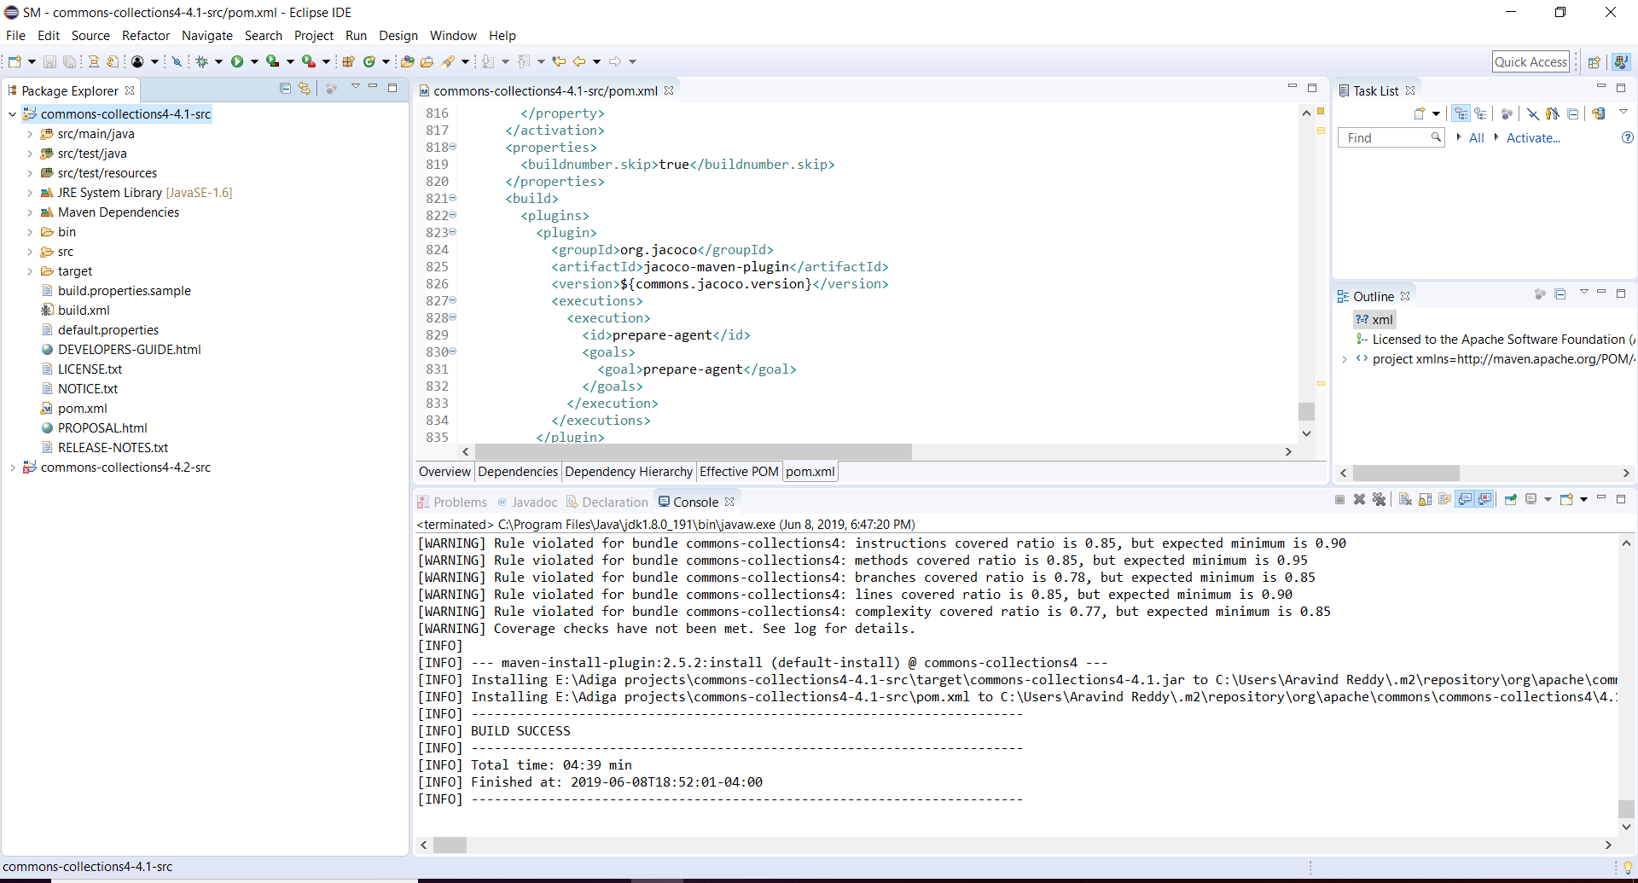
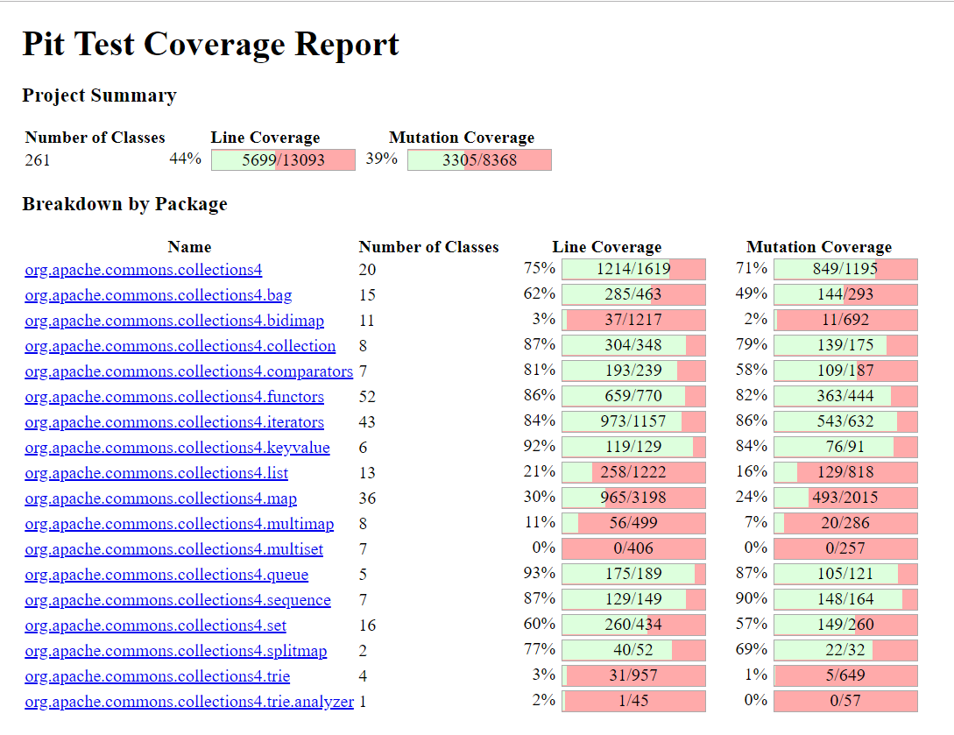
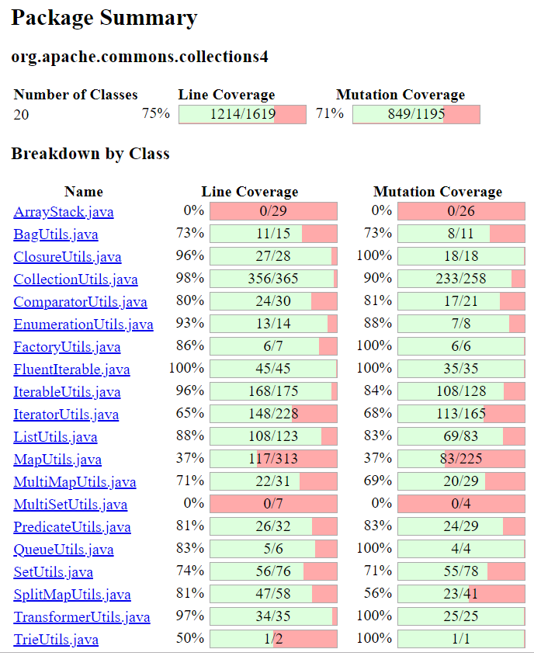

Example : Apache Commons Collections Package level

Slide 9
Code Complexity : McCabe (Metric 4)
It measures the number of linearly independent paths for a program
Calculate as :
CC = E – N + 2P
E – number of edges in the graph
N – Number of nodes in the graph
P – Number of connected components
Example : For Apache Commons Collections : Average complexity = 15.25

Slide 10
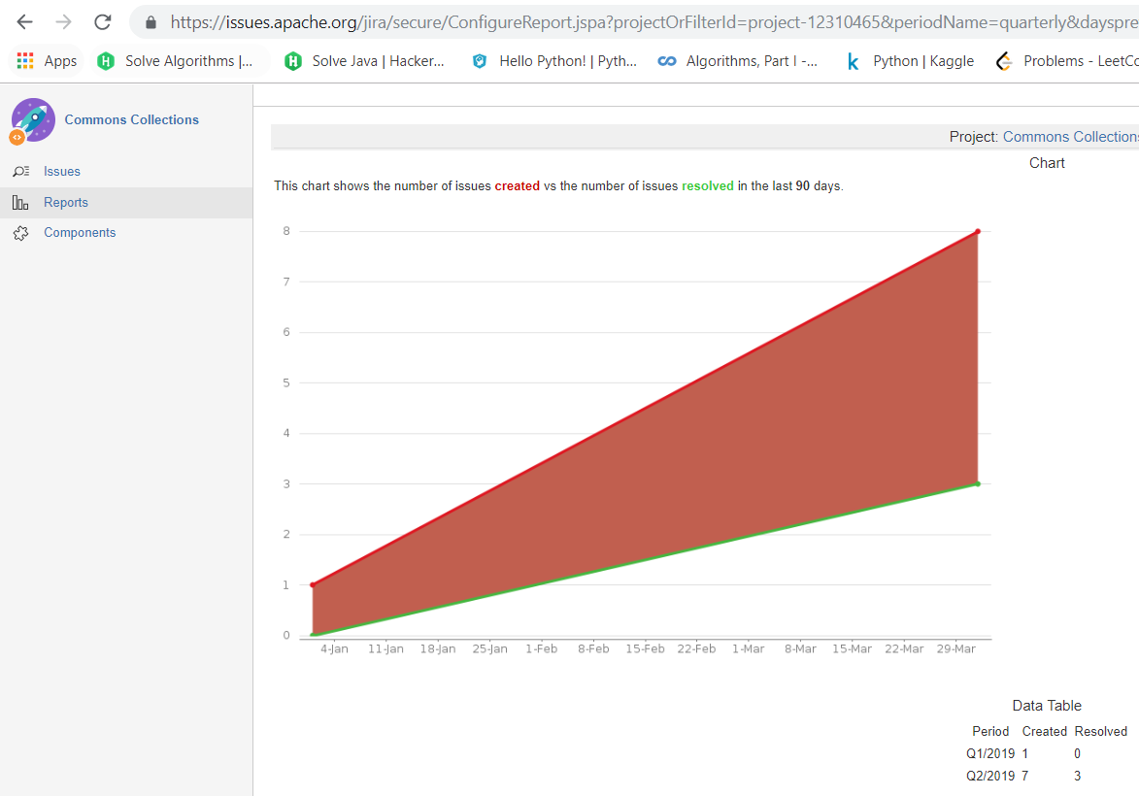
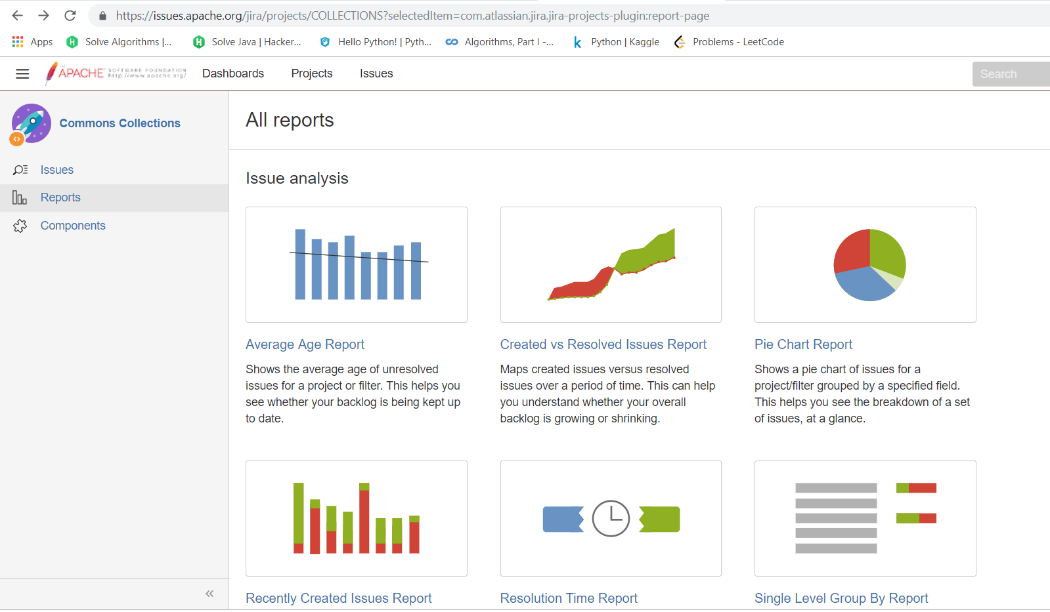
BackLog Management Index(BMI) : Metric 5
BMI = ( Number of defects closed per month/Number of defects created ) * 100
BMI = (18/32) * 100 = 56.25%
Note : we have considered average values over months, since monthly data was insignificant.

Slide 11
Post-release defect density : Metric 6
DD = (Number of defects / Number of LOC)
Examples(Considered latest versions)
JfreeChart = 53/317k = 0.0001671
Apache Commons Collections = 29/132k = 0.0002196
Apache Commons Lang = 6/80.7k = 0.00007434
Apache Commons Math = 17/186k = 0.00009139

Slide 12
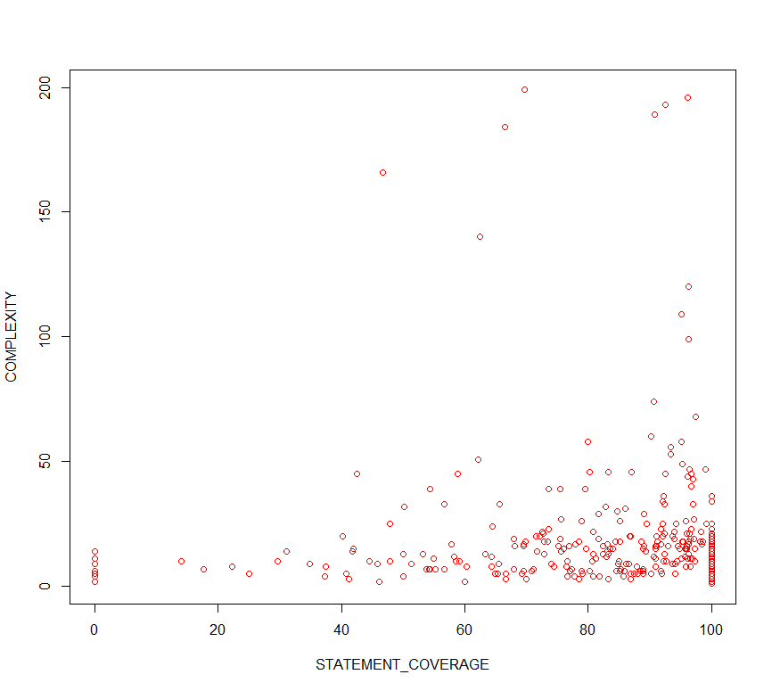
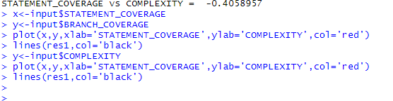
Correlations : (For Apache Commons Collections)
Metric 1 & Metric 4 : Statement vs Complexity

Slide 13
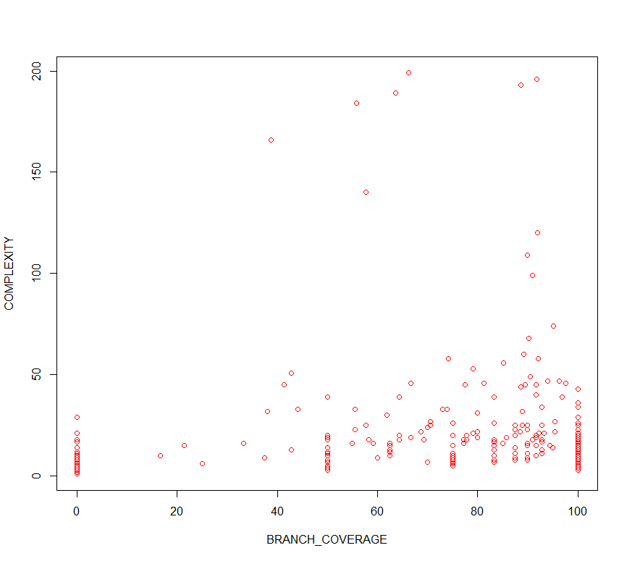

Correlations : (For Apache Commons Collections)
Metric 2 & metric 4 : Branch vs Complexity

Slide 14
Correlations : (For Apache Commons Collections)
Metric 5 and Metric 6 : BMI vs Defect Density
The correlation between metric 5 and 6 is the average of BMI and Defect Density on the selected version for the project.
The Spearman Coefficient is 0.86, which means there is a strong positive correlation between the above mentioned metrics

Slide 15
Related work
Rahmani, C. (2019). A Study on Defect Density of Open Source Software. [online] Available at: https://www.researchgate.net/profile/Deepak_Khazanchi/publication/221635599_A_Study_on_Defect_Density_of_Open_Source_Software/links/0c9605249a82ab8af0000000.pdf
Ahamed, A. (2019). Backlog Clearance Planning Index - A Proactive Approach to Backlog Management. [online] Available at: https://independent.academia.edu/AshfaqAhamedMohammed
THUNG, F., SINGH, P. and LO, D. (2019). Code Coverage and Test Suite Effectiveness: Empirical Study with Real Bugs in Large Systems. [online] Mysmu.edu. Available at: http://www.mysmu.edu/faculty/davidlo/papers/saner15-coverage.pdf

Slide 16
References :
Wiedmann, J., Wiedmann, J., & profile, V. (2011). The mess that is m2e connectors. Grumpyapache.blogspot.com. Retrieved 1 April 2019, from http://grumpyapache.blogspot.com/2011/08/mess-that-is-m2e-connectors.html
objectledge/maven-extensions. (2019). GitHub. Retrieved 1 April 2019, from https://github.com/objectledge/maven-extensions
EclEmma - JaCoCo Java Code Coverage Library. (2019). Eclemma.org. Retrieved 1 April 2019, from https://www.eclemma.org/jacoco
Use of relative code churn measures to predict system defect density - IEEE Conference Publication. (2019). Ieeexplore.ieee.org. Retrieved 1 April 2019, from https://ieeexplore.ieee.org/document/1553571
CLOC -- Count Lines of Code. (2019). Cloc.sourceforge.net. Retrieved 1 April 2019, from http://cloc.sourceforge.net/
PIT Mutation Testing. (2019). Pitest.org. Retrieved 2 March 2019, from http://pitest.org/

Slide 17
Thank You

